Slide 1
Agnus Dei!
Your new Family

Slide 2


Slide 3

Goals!
Become a large community of gamers
Become known throughout the halo universe
Place and win throughout tournaments

Slide 4

Electronic Sports League
Open Cup tournaments 4v4!
First cup Sunday Nov 30th
Roster needs 5 people
Winning or placing possible
128 or more teams
http://play.eslgaming.com/play/join_team/?teamid=8762136&joinpw=dei15

Slide 5

Halo Championship series
All halo 2 anniversary
4v4 all types
3 games per match
Esl plays through this system

Slide 6

Current Roster
Mastert183 (overseer)
Kargoth05 (staff sgt.)
Phoenixwolf388 (Commander)

Slide 7


Sponsors
Acidic Gaming

Slide 8
Contact us
Twitter - @agnusdei2015
Facebook – agnusdei2015@gmail.com
Email- Agnusdei2015@gmail.com
Website- http://tylerphipps68.wix.com/agnusdei
Gamertags
Tyler (mastert183) leader
Grant (Phoenixwolf388) commander
Tyler (kargoth05) Staff sgt

Slide 9
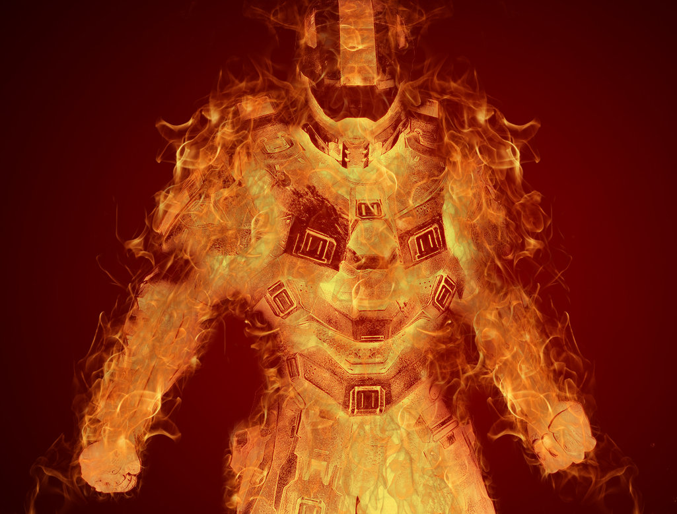
Lets do this Agnus!

